Slide 1

Telecom Customer Churn Analysis

Slide 2
About me :-
Name :- Disha Sudhakar Suryawanshi
Education :- G. H. Raisoni college of engineering and business management ,Jalgaon.
• Why I Want To Learn Data Science :- I want to learn data science because ,I’ve always been curious about how companies makes the decision about what customers likes or dislikes, that urge of knowing how this decision making works in companies created my interest in data science .
• Connect With Me :- LinkedIn - www.linkedin.com/in/dishasuryawanshi0104
GitHub - https://github.com/Dishasuryawanshi0104

Slide 3
Business Objectives :-
To Identify customers who are most likely to churn.
To Analyze churn behavior across customer demographics (gender, senior citizen).
To Understand the impact of services, contract type, tenure, and billing on churn.
To Measure overall churn rate and key customer KPIs.
To Enable interactive analysis through Power BI dashboards for informed decision-making.

Slide 4
Approach of Business Objective -
Collected and understood telecom customer data related to demographics, services, billing, and churn.
Cleaned and transformed the data using Power Query to ensure accuracy and consistency.
Segmented customers based on demographics (gender, senior citizen), tenure, contract type, and services.
Analyzed churn trends across different customer segments using interactive visuals.
Built an interactive Power BI dashboard with slicers for deeper analysis.
Derived actionable insights to support business decisions for reducing customer churn

Slide 5
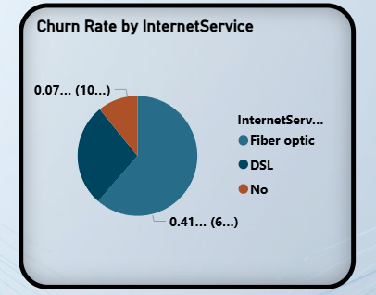
Churn Rate By Internet Service
Insights –
Fiber Optic customers show the highest churn rate.
DSL customers have a comparatively lower churn rate than Fiber Optic.
Customers with no internet service have the lowest churn contribution.

Slide 6
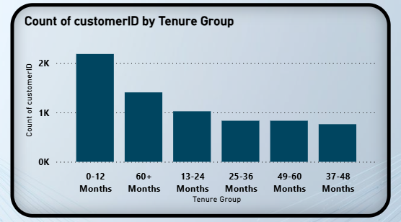
Count of Customer_ID by Tenure Group
Insights –
The highest number of customers fall in the 0–12 months tenure group.
Customer count decreases as tenure increases
Long-tenure customers (37+ months) form a smaller but stable customer base.

Slide 7
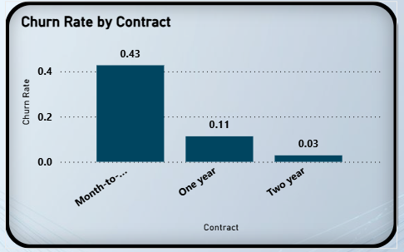
Churn Rate by Contract Type
Insights –
Month-to-Month contracts have the highest churn rate.
Churn rate drops sharply for One-Year contracts.
Two-Year contracts have the lowest churn rate.

Slide 8
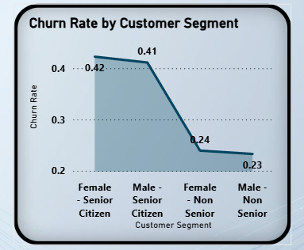
Churn Rate by Customer Segment
Insights –
Senior citizens have significantly higher churn rates.
Non-senior customers show comparatively lower churn rates.
Female senior citizens have the highest churn rate among all segments.

Slide 9
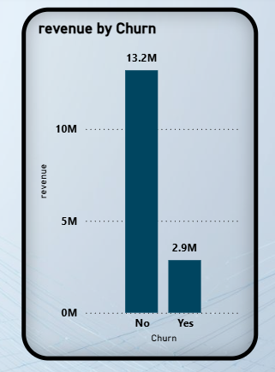
Revenue by Churn
Insights –
Churned customers contribute significantly less revenue than active customers.
Customer churn leads to substantial revenue loss for the business.
Retaining existing customers is more valuable than acquiring new ones.

Slide 10
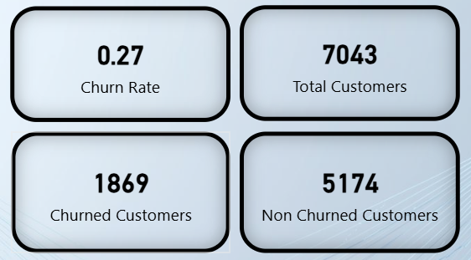
Key Churn KPIs Overview

Slide 11
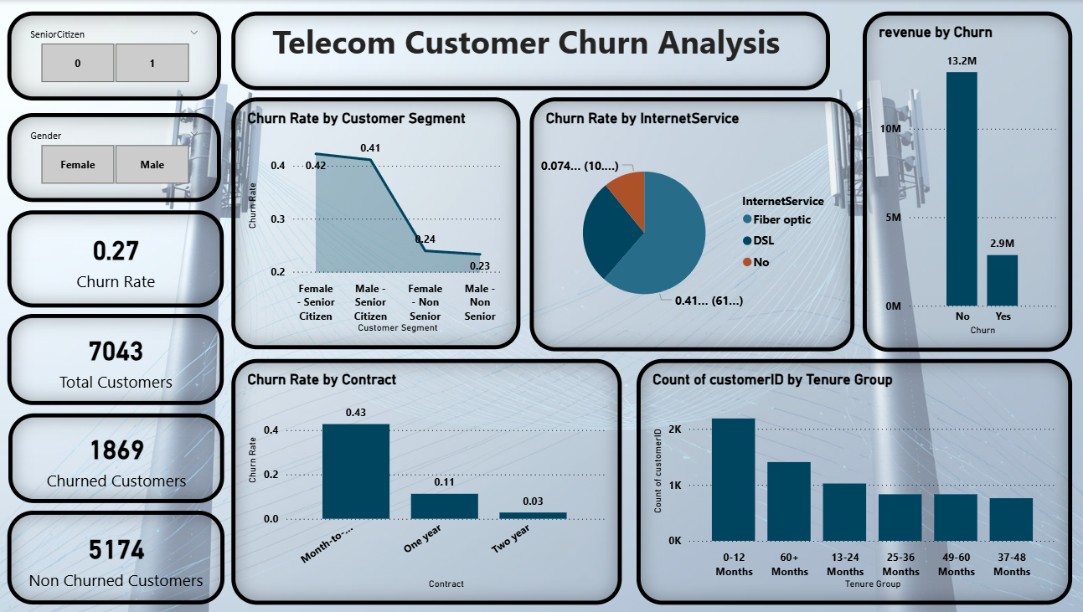

Slide 12
Experiences and Challenges
Experiences –
Improved understanding of customer churn behavior and business impact.
Strengthened skills in Power BI, Power Query, and DAX.
Learned how to convert raw data into meaningful business insights.
Developed interactive dashboards to support data-driven decision-making.
Challenges –
To Identifying the most relevant churn drivers from multiple variables.
To Create accurate measures using DAX.
To Balance dashboard design between visual appeal and analytical clarity.

Slide 13
Conclusion
Continuous churn monitoring is essential for long-term business success.
The analysis successfully identified key patterns and drivers influencing customer churn in the telecom business.
Interactive dashboards enable stakeholders to monitor churn trends and support data-driven decision-making.
The insights derived from this analysis can help businesses design targeted strategies to improve customer retention and long-term profitability.

Slide 14

THANK YOU

